Slide 1
Force Field Parameterization of a Small Molecule
Hemanth Haridas
Clark Group
Henry Eyring Center for Theoretical Chemistry
University of Utah
Email: hemanth.haridas@utah.edu

Slide 2
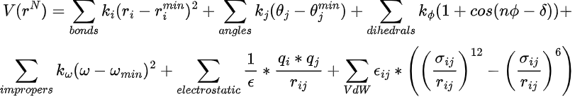
What is a Force Field?
BONDS
CG1N1 CG2R61 345.00 1.4350
CG1N1 CG331 400.00 1.4700
CG1N1 NG1T1 1053.00 1.1800
CG1T1 CG1T1 960.00 1.2200
DIHEDRALS
CG2R53 CG251O CG25C1 CG2R53 6.4000 2 180.00
CG2R53 CG251O CG25C1 CG2RC0 6.4000 2 180.00
NG2R53 CG251O CG25C1 CG2R53 3.4000 2 180.00
NG2R53 CG251O CG25C1 CG2RC0 3.4000 2 180.00
ANGLES
CG2R61 CG1N1 NG1T1 40.00 180.00
CG331 CG1N1 NG1T1 21.20 180.00
CG1T1 CG1T1 CG331 19.00 180.00
CG1T2 CG1T1 CG331 11.00 180.00
Force constants for bonds > Force constants for angles > Force constants for dihedrals
Why??

Slide 3
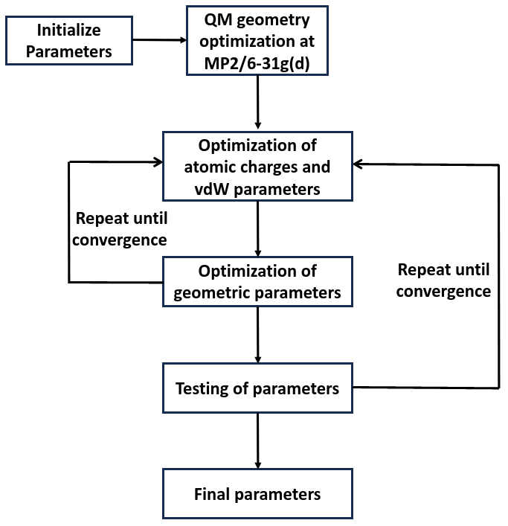
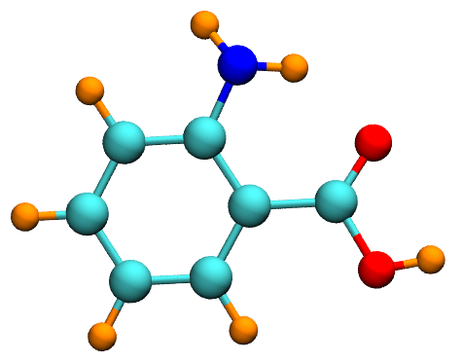
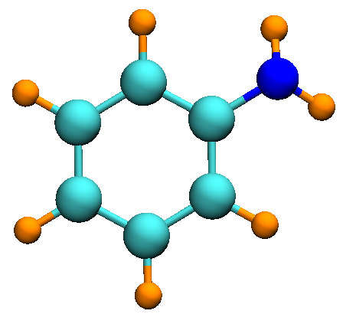
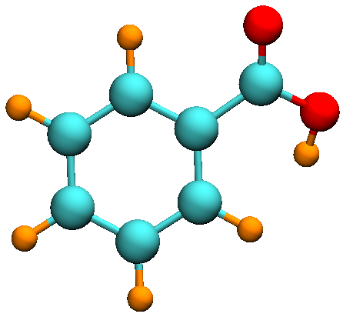
CHARMM Parameterization Strategy

Slide 4
Charge Fitting
Generate QM Target Data
Generate MM Data
Update MM charges
No
Converged?
Yes
Final Parameters

Slide 5
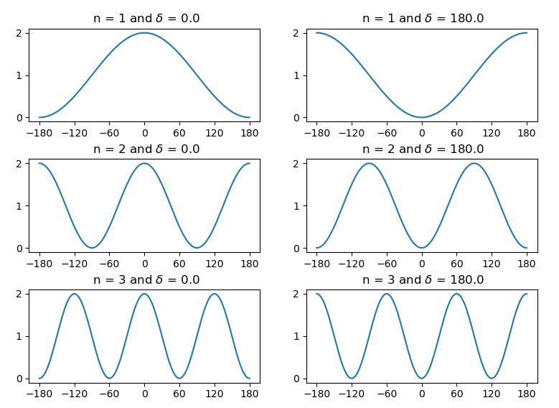
Dihedral Fitting

Slide 6
Dihedral Fitting
Generate QM Target Data
Generate MM0 Target Data
Run lsfit to get new dihedral parameters
Update multiplicity and (or) delta
No
Transfer and test the parameters
Converged
Yes
Final Parameters

